Slide 1
Cystic fibrosis
Krystal Turner
September 10, 2021
RET2946

Slide 2
Cystic Fibrosis
Cystic fibrosis is a progressive, genetic disease that causes persistent lung infections and limits the ability to breathe over time.
In people with CF, mutation in the cystic fibrosis transmembrane conductance regulator (CFTR) gene cause the CFTR protein to become dysfunctional. When the protein is not working correctly, it’s unable to help move chloride -- a component of salt -- to the cell surface. Without the chloride to attract water to the cell surface, the mucus in various organs becomes thick and sticky.

Slide 3
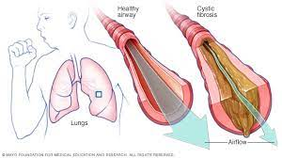

Slide 4
Symptoms
Very salty-tasting skin
Persistent coughing, at times with phlegm
Frequent lung infections including pneumonia or bronchitis
Wheezing or shortness of breath
Poor growth or weight gain in spite of a good appetite
Frequent greasy, bulky stools or difficulty with bowel movements
Male Infertility

Slide 5
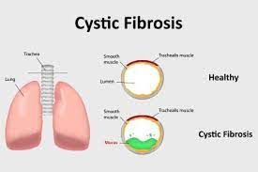

Slide 6
Causes
The infection occurs due to the defect on the cystic fibrosis transmembrane conductance regulator (CFTR) gene which is responsible for the control of water and salt movement within the body cells.
Cystic fibrosis is a genetic disease People with CF have inherited two copies of the defective CF gene -- one copy from each parent. Both parents must have at least one copy of the defective gene.
The defective CF gene contains a slight abnormality called a mutation. There are more than 1,700 known mutations of the disease. Most genetic tests only screen for the most common CF mutations. Therefore, the test results may indicate a person who is a carrier of the CF gene is not a carrier.
Infants are usually tested if they have an intestinal blockage which is caused by the meconium ileus.

Slide 7
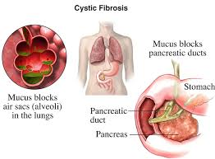

Slide 8
Diagnosing
Diagnosing cystic fibrosis is a multistep process, and should include a newborn screening, a sweat test, a genetic or carrier test, and a clinical evaluation at a CF Foundation-accredited care center. Although most people are diagnosed with CF by the age of 2, some are diagnosed as adults. A CF specialist can order a sweat test and recommend additional testing to confirm a CF diagnosis.
A most common type of diagnosis of CF is done at birth for infants and other signs might be identified later by the doctors and the sweat test will be taken.
The screening of the new bones takes place with blood tests and sweat tests. The sweat test is done with the chloride, in which high amounts of chlorides illustrates that an infant has cystic fibrosis.
In children, less than six months require to have 30mmol/L and the between 30 to 59 is considered as high while high chloride levels are measured at 60mm0l/L(Rosenfeld et al., 2001). Other signs and symptoms of cystic fibrosis can be used by the doctors to determine if the infants have CF and recommend treatment.

Slide 9
Management
Each day, people with CF complete a combination of the following therapies:
Airway clearance to help loosen and get rid of the thick mucus that can build up in the lungs.
Inhaled medicines to open the airways or thin the mucus. These are liquid medicines that are made into a mist or aerosol and then inhaled through a nebulizer and include antibiotics to fight lung infections and therapies to help keep the airways clear.
Pancreatic enzyme supplement capsules to improve the absorption of vital nutrients. These supplements are taken with every meal and most snacks. People with CF also usually take multivitamins.
An individualized fitness plan to help improve energy, lung function, and overall health
CFTR modulators to target the underlying defect in the CFTR protein. Because different mutations cause different defects in the protein, the medications that have been developed so far are effective only in people with specific mutations.

Slide 10
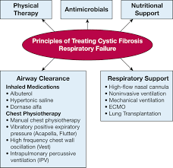

Slide 11
Reference
https://www.cff.org/
https://journal.chestnet.org/
https://www.healthline.com/health/cystic-fibrosis#symptoms

